Slide 1
Pre-bid Conference 15722 – Vehicle Maintenance and Repair Services
Alec La Brayere, Procurement Coordinator
Contracts & Procurement Division
10/4/2023

Slide 2
Pre-Bid Administration
Please mute yourselves to avoid background noise
Please raise your virtual hand to speak
Please submit all questions to:
DESContractsTeamMaple@des.wa.gov
Washington’s Electronic Business Solution (WEBS)

Slide 3
Disclaimer
Bidders should only rely on written postings and amendments issued via WEBS. All other communications will be considered unofficial and non-binding on DES. Should bidders rely on any other communication, they do so at their own risk and expense.

Slide 4
Agenda
Enterprise Services introduction
Vehicle Maintenance and Repair Services Bid Opportunity
Additional resources

Slide 5
Enterprise Services
Authority to create statewide contracts for the state
Procurement bridge between purchasers and contractors
State Procurement Priorities

Slide 6
Eligible Purchasers
State agencies
Use DES statewide contracts unless the contract cannot justifiably satisfy the agency needs.
Other eligible purchasers
Optional use with Contract Usage Agreement
Political Subdivisions
Tribes in WA
Federal Agencies in WA
Public Benefit Nonprofits in WA

Slide 7
PROCUREMENT SCOPE
Vehicle Maintenance and Repair Services
The procurement scope includes maintenance, repair, and body repair, for both ICE and Electric Vehicles
Contracts will be awarded by category – ICE Vehicle Maintenance, ICE Vehicle Repair, Body Repair, and Maintenance and Repair Services for Electric Vehicles.
Contracts will be awarded by county. All counties are available to be bid on.

Slide 8
PROCUREMENT SCOPE
Multiple Awards and Reserved Awards
Each county will have multiple awarded contracts, per category.
Some awards in each county will be reserved awards for small and/or veteran owned businesses.
If not enough small and/or veteran owned businesses apply, those awards would be converted to non-reserved awards.

Slide 9
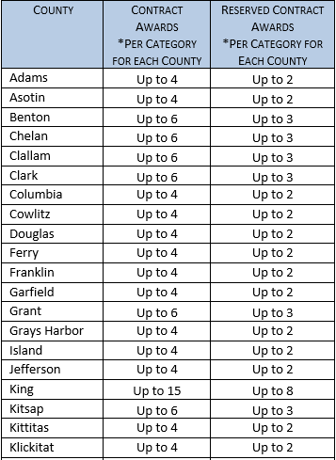
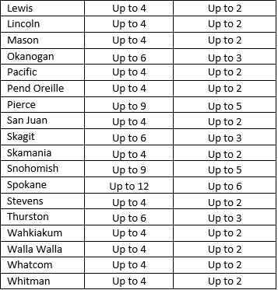

Slide 10
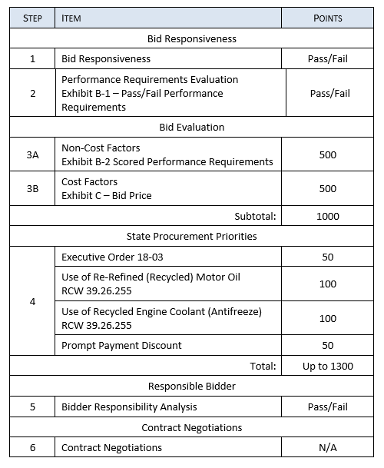

Slide 11
EXHIBITS A-1 and A-2
Bidder’s Certification and Bidder’s Profile
Exhibit A-1 Bidder’s Certification is for certifying the identity of the bidder, as well as understanding of and compliance with the contract terms. This document is also where you will indicate whether you are seeking preference points or to bid for a reserved award.
Exhibit A-2 Bidder’s Profile is for providing further details about the bidder’s identity, including points of contact, required references and business locations.

Slide 12
EXHIBITS B-1 and B-2
Performance Requirements
Exhibit B-1 requirements are pass/fail – if you do not agree to these, the bid will be considered non-responsive.
Exhibit B-2 requirements are scored – scores will be compared to other bids in the same category and county.

Slide 13
EXHIBIT C – PRICE
Pricing Structure
All bid prices for services are labor rates in $/hr.
Parts costs are bid as a % markup above what bidder pays for the parts.
Must bid on all items in a category to be responsive
Leave counties and/or categories you are not bidding for blank
Prices are scored – 90% for services, 10% for parts markup. Scores will be compared to other bids in the same category and county.

Slide 14
EXHIBIT C – PRICE

Slide 15
EXHIBIT D –Contract
Contract Document
This is the contract itself
Some items will change based on responses in the bid
You do not need to fill anything out or submit this document, but you do need to read it.

Slide 16
STATE PROCUREMENT PRIORITIES
Small businesses and Veteran-owned businesses – reserved awards, all categories
EO-18-03 – 50 points, all categories
Recycled Motor Oil, 100 Points, ICE Maintenance category only
Recycled anti-freeze, 100 points, ICE Maintenance and Electric Vehicle Maintenance and Repair categories only

Slide 17
CONTRACT
Contract term: 2 years with up to 24 months performance-based extension
Pricing is fixed for the first year
Annual, automatic economic price adjustment based on BLS index for automotive maintenance and repair workers.
Quarterly sales reporting
Vendor management fee of 1.25% - Must be included in total price
Due 30 days after Invoice is received

Slide 18
Insurance Requirements
Workers Compensation Insurance
Employer’s Liability (Stop Gap) Insurance
Not less than $1,000,000 each accident for bodily injury by accident
Not less than $1,000,000 employee for bodily injury by disease
Not less than $1,000,000 bodily injury by disease policy limit
Garage Liability Insurance
Not less than $1,000,000 per occurrence and $2,000,000 general aggregate.
Must include blanket contractual liability coverage.
Must include a cross-liability clause or separation of insured condition.
Garage Keeper’s Liability Insurance
Minimum $100,000
Insurance Carrier Rating – A- or better according to Best’s Insurance Rating
State of WA/DES and purchasers must be listed as Additional Insureds
Must provide Certificate of Insurance, and proof of renewal if it expires during the contract term
If using subcontractors, they all must be included under all required policies

Slide 19
HOW TO SUBMIT A BID
Review all solicitation and contract terms
Submit a bid before the due date and time
Email bid submittals to: DESContractsTeamMaple@des.wa.gov
Provide all completed Exhibits:
Exhibit A-1 – Bidder’s Certification
Exhibit A-2 – Bidder’s Profile
Exhibit B-1 – Pass/Fail Performance Requirements
Exhibit B-2 – Scored Performance Requirements
Exhibit C – Price
Exhibit E – Diverse Business Inclusion Plan - Subcontractors

Slide 20
QUESTION AND ANSWER PERIOD
Bidders are encouraged to ask questions
Q&A are posted in WEBS
Some Q&A may lead to solicitation amendments

Slide 21
Timeline and next steps
Question and Answer period:
Questions due December November 15th, 2023.
Final answer document posted November 22nd, 2023.
Bid due date: December 8th, 2023.
Anticipated announcement of apparent successful bidder: February 14th, 2024
Anticipated contract award: April 11th, 2024.

Slide 22
COMPLAINTS/DEBRIEFS/PROTESTS
Complaints
Complaint period ends 5 business days before the bid due date.
Debrief Conferences
Bidders have 3 business days to request a Debrief Conference after announcement of Apparent Successful Bidder(s).
Protests
Must have participated in debrief conference
Bidders may protest the award only for three reasons:
Bias, discrimination, or conflict of interest of an evaluator;
Error in computing evaluation scores; or
Non-compliance with any procedures described in the Competitive Solicitation.

Slide 23
ADDITIONAL RESOURCES
Washington Electronic Business Solution (WEBS)
Statewide Payee Desk
Washington APEX Accelerator, formerly (PTAC)
Office of Minority and Women's Business Enterprises (OMWBE)
Washington Department of Veterans Affairs (DVA)
Washington Department of Revenue (DOR)
Washington Secretary of State (SOS)

Slide 24
thank you
DESContractsTeamMaple@des.wa.gov
Attn: Alec La Brayere
360-407-9366
Enter web address here

